Slide 1
Late Jurassic to Eocene Evolution of the Cordilleran Thrust Belt and Forland Basin System, Western U.S.A.
P. G. DeCelles
2004
Presented by James McNeil

Slide 2
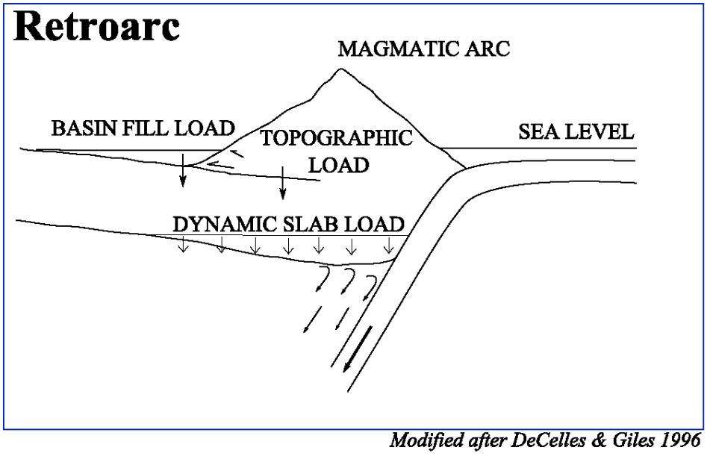
Tectonic Map
North American Cordillera
~6,000 km from Mexico to Alaska
Maximum width of >1000 km
Constructed during mid-Mesozoic-Eocene
No other mountain belt-foreland basin couplet equals the North American Cordilleran system (~100 Myr) in terms of area and system duration
This Paper: Uses geochronological, structural, and sedimentological data for a summary of the regional evolution of the NA Cordilleran thrust belt

Slide 3
Five fundamental questions in cordilleran retroarc tectonics
1. What was the timing of initial shortening in the retroarc region, and how does this earliest shortening fit within the broader pattern of retroarc orogenesis?

Slide 4
Five fundamental questions in cordilleran retroarc tectonics
2. What was the temporal relationship between hinterland extension and frontal thrusting in the Cordilleran thrust belt?

Slide 5
Five fundamental questions in cordilleran retroarc tectonics
3. What were the dominant controls on regional subsidence in the foreland basin system, and how did these mechanisms vary in time?

Slide 6
Five fundamental questions in cordilleran retroarc tectonics
4. Are tectonic events in the western hinterland region related to younger events farther east in a continuum of eastwad-propagating deformation, or are the various thrust belts of the retroarc unrelated?

Slide 7
Five fundamental questions in cordilleran retroarc tectonics
5. Is there a relationship between retroarc thrusting and arc magmatism in the Cordillera?

Slide 8
Important Issues
1. Timing of onset and regional pattern of crustal shortening in the retroarc
2. Nature of the relationship between crustal thickening and extension in the hinterland and Sevier belt thrusting
3. Driving mechanism(s) of subsidence in the retroarc foreland basin system
4. Degree of temporal and spatial continuity in orogenesis in the Cordilleran thrust belt
5. Relationship between retroarc thrusting and arc magmatism

Slide 9
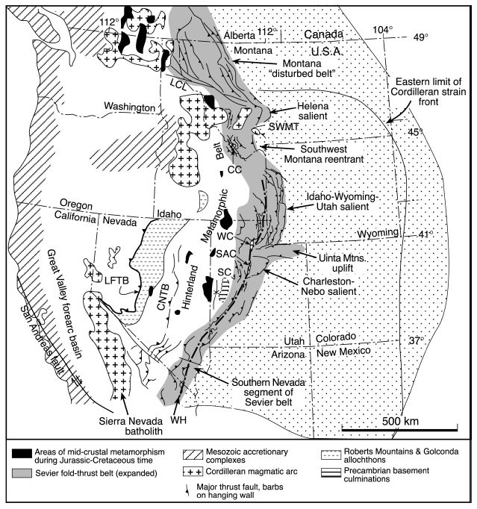
Tectonic Map
CRO, Coast Range ophiolite; LFTB, Luning-Fencemaker thrust belt; CNTB, Central Nevada thrust belt; WH, Wasatch hinge line; UU, Uinta Mountains uplift; CBM, Crazy Mountains basin; PRB, Powder River basin; DB, Denver basin; RB, Raton basin

Slide 10
Major Structures of the NA Cordillera
Geochronologic, thermochronologic and provenance data indicating the timing of tectonic, plutonic, and metamorphic activity

Slide 11
Thrusting and Arc Magmatism
Time-displacement curve
Average rate of seafloor spreading
Comparison of cumulative shortening in the central Utah-Nevada Sevier belt and Laramide province
Large eastward excursions of arc magmatism up to ~1000 km during two pulses
Late Jurassic (~157-148 Ma)
Late Cretaceous-Eocene (~80-45 Ma)
Most rapid shortening during
Early Cretaceous (~140-110 Ma)
Late Cretaceous-Eocene (~85-55 Ma)
No apparent link between timing of thrusting and arc magmatism

Slide 12
Mechanisms of Subsidence in Retroarc Foreland Basins

Slide 13
Late Jurassic (~155-142 Ma)
Convergence oriented NW-SE
Transtension and sinistral strike-slip tectonics in the south
Timing and intrusion of Independence dike swarm in southern Sierra NV/Mojave
Regional shortening in the northern section – Luning-Fencemaker thrust belt - LFTB (~165-150 Ma)

Slide 14
Late Jurassic (~155-142 Ma)
Accumulation of Morrison Fm. (Late Jurassic) in retroarc of Montana, Wyoming, Utah, and western Colorado – western source
Sandstone compositions shown in ternary diagrams (Quartz, feldspar, total lithics)
Mechanism(s) of basin subsidence?
Morrison Fm. does not thicken westward → not due to flexural loading
Paleocurrent
Morrison Fm.

Slide 15
A. Comparison of predicted flexural subsidence related to LFTB
B. and C. East-west cross sections at lithospheric scale
Hypothetical plate tectonic processes beneath western U.S.A. during Late Jurassic-early Cretaceous time

Slide 16
Eastward pulse of Late Jurassic magmatism in Utah and Nevada
Low-angle subduction of Farallon plate could have caused eastward migration of arc magmatism
Partial delamination of thickened lithosphere beneath Nevada could have steepened the geotherm and formed melts in lower crust
Regional isostatic rebound and erosion of proximal Morisson Fm. could be driven by slab flattening and steepening model or by partial lithospheric delamination

Slide 17
Early Cretaceous (~142-112 Ma)
Volume of arc magmatism dramatically decreases
Eastern front of the arc retreats hundreds of km to the west
Arrows and contours → Barremian (?) –Aptian fluvial deposits

Slide 18
Albian (~112-98.5 Ma)
Widespread plutonism and metamorphism with localized crustal shortening in the hinterland
Continued regional displacement of major thrust sheets in the western Sevier belt
Shaded region → marine inundation
Marine waters enter foreland from the north and connect with the Gulf of Mexico
Suggestion of thick foredeep depozone adjacent to the thrust belt

Slide 19
Cenomanian (~98.5-93.3 Ma)
Possible forebulge location
Igneous intrusion and metamorphism in NV hinterland
Minimal magmatic activity in Utah and Idaho
Two episodes of thrust-related burial in the mid-crust with an episode of exhumation-driven cooling separating them
Major marine transgressions

Slide 20
Turonian (~93.3-88.7 Ma)
Forebulge possibly situation further east than in Cenomanian time (as far east as central Colorado)
Major marine transgressions
Widespread carbonate deposition
Possible forebulge location
Limestone

Slide 21
Coniacian-Santonian (~88.7-83.5 Ma)
Mid-crustal rocks located in the interior of the trust belt in western Utah and eastern Nevada experience
Dramatic crustal shortening (top to the east)
Up to amphibolite grade metamorphism
Crustal anatexis (partial melting)
Inland seaway continues and carbonate deposition continues
Asymetric pattern of subsidence in Turonian shifts east and becomes more symmetrical → suggests dynamic subsidence beginning to influence Cordilleran retroarc region

Slide 22
Campanian (~83.5-71.3 Ma)
Peak metamorphism P/T conditions are reached in mid-crustal rocks in the interior of the trust belt
Metamorphism linked to crustal thickening in NW Utah and NE Nevada
Local exhumation and cooling in the interior of the thrust belt during early Campanian time
Sevier belt frontal trust propagates eastward
Magmatism migrates into central Rocky Mountains linked to decreased subduction angle of the Farallon plate

Slide 23
Maastrichtian (~71.3-65.4 Ma)
Climax of Laramide intraforeland uplift and the last major phase of thin-skinned shortening in the Cordilleran thrust belt
Thrusting in the frontal Sevier belt continues
Suggestion that the Laramide region is the frontal part of the Cordilleran orogenic wedge (assuming intraforeland faults branch upward from a regional mid- or lower crustal shear zone)

Slide 25
Kinematic History of Cordillera
Large scale temporal and spatial patterns of kinematic, metamorphic, igneous, and sedimentary events in the Cordilleran thrust belt

Slide 26
Conclusions
Shortening begins Late Jurassic
Thickening of basement along mid-crustal shear zones in the hinterland along Wasatch hingeline (central Utah, eastern Idaho, and southwestern Montana)
Mid-crustal rocks in the interior of the thrust begin dramatic exhumation and cooling
Possibly from crustal thinning due to extension
Thin-skinned thrust systems form in Wyoming in fontal Sevier belt
Peak crustal thickness reached and gravitational collapse begins

Slide 27
Conclusions
Arc magmatism shifts hundreds of kilometers to the east TWICE!
Late Jurassic – may be linked to lithospheric foundering and inferred dynamic uplift in the foreland region that interfered with orogenic load-driven flexural subsidence
No obvious connection between voluminous arc-magmatism and westward underthusting of NA lithosphere beneath the arc
Delamination of NA lithosphere could have facilitated rapid Early Cretaceous thrusting by removing a large chunk of lithosphere under the retroarc thrust belt

Slide 28
Conclusions
Late Cretaceous → broad, low-relief, high elevation hinterland plateau “Nevadaplano” and a topographically rugged frontal trust belt
Sediment accumulation occurs in the trust belt and foreland basin system due to several processes
Flexural subsidence dominant (Early Cretaceous to Turonian ~142-89 Ma)
Regional subsidence associated with subducting Farallon slab (Late Jurassic and Late Cretaceous)
Laramide uplifts and basins in the foreland (Late Cretaceous to Eocene)

Slide 29
Conclusions
Take Home Point: There likely is not a link between the timing of thrusting and magmatism in the arc, but instead ~20 Myr of lag-time between shortening and coeval underthrusting, and arc melt generation. However, delamination of the lithosphere may have allowed for rapid Early Cretaceous continental underthrusting that could have resulted in the Late Cretaceous flare-up.

